Slide 1
Agenda
Typescript
Angular Features
Why Angular
Angular Architecture
Bootstrapping & Compilation
Angular CLI
Components
Modules
Templates, Interpolation, Directives
Life Cycle Hooks
Binding
Pipes
Forms
Angular Material
Services & Dependency Injection
Routing & Navigation
Http, Observables, RxJs
Authentication
State
Unit Testing
Deployment

Slide 2
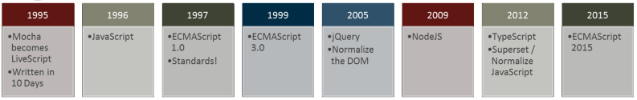
JS Journey
“TypeScript is a typed superset of JavaScript compiled to JavaScript”
JS is everwhere and huge amount of libraries

Slide 3
Javascript problems
Application scale JavaScript development is hard.
Dynamic typing
Lack of modularity
Scope can’t be defined at block level
OOPS is hard (eg Based on object extension. Not class inheritance )
Javascript development scales badly
JS is designed for small things
We now use to do big things
AJAX and REST = never refresh the page
But JavaScript is not suited for building large applications
Your JavaScript code gets complex; it becomes extremely unwieldy

Slide 4
Problem - dynamic types
Variables are untyped and dynamic. They are flexible
Bad because it is so easy to get wrong
var x = 1; var y = x + 1; // OK, type is inferred. can assume x and y are both numbers.
var x = 1; x = "hello"; // NOT OK, type is mixed up. We can't assume what type is x.
// JS is interpreted. There are no design-time intellisense or compile-time assistance to help you point out errors

Slide 5
Problems - parameters
Define a function with arguments. That is your contract with your caller. Unfortunately, in JavaScript, function parameters are more like guidelines, because callers don't take them seriously
function f(x) { return x + 1; }
f("hello"); f(1234); f(); f(function(){}); f([4]); f("hello", "world");
// and then we have this magic object. function f() { console.log(arguments.length); } f(1,1,2,2);
// Where did arguments come from? // Caller can still do whatever they want. Callee has to be defensive and check everything.
// It is so easy to get wrong

Slide 6
Problem - scope
JavaScript's scope looks like C#, but does not work at a block level. It is at the function level.
It is so easy to get wrong
var i = 1; if (i == 1) { var i = 2; } var y = function { var i = 3; }
Notes:
// not a reference to coffeescript
// y is function closure - exposes an inner function, allowing the inner variable x.foo to be modified externally.
// extremely important in event handling, but difficult without strong coffee.

Slide 7
Problem - object inheritance is hard
Based on object extension. Not class inheritance (at a syntax level)
var animal = { var name; }; var cat = jQuery.extend( animal, var claw = function() { /*claw*/ }; });
//Syntax complicated, so nobody really does it.

Slide 8
Typescript overview
“TypeScript is a typed superset of JavaScript that compiles to plain JavaScript.”
Any browser. Any Host. Any OS. Open source. - strongly supported by Microsoft
Made in Microsoft in 2012 and released as version – 0.8 ...Created by the father of C# Anders Hejlsberg
TypeScript adopts its basic language features from the ECMAScript5 specification
JS
TS
JS
Copy JS code
Into TS file
Compile to JavaScript

Slide 9
Why Typescript?
Starts with JavaScript
All JavaScript code is TypeScript code, simply copy and pasteAll
JavaScript libraries work with TypeScript
Optional static types, classes, modules
Enable scalable application development and excellent tooling
Zero cost: Static types completely disappear at run-time
Ends with JavaScript
Compiles to idiomatic JavaScript
Runs in any browser or host, on any OS

Slide 10
Type System
Formalization of JavaScript’s types Static representation of JavaScript’s dynamic type system
Type inference and structural typing
In practice very few type annotations are necessary
Works with existing JavaScript libraries
Declaration files can be written and maintained separately
Not “provably type safe”
Types reflect intent but do not provide guarantees

Slide 11
Why Typescript?
TypeScript is a language for application scale JavaScript development.
Modular Development
Scalable HTML5 client side development
Static Typing / Optional Typing
Disappear at runtime with zero cost
Compilation
Syntax checking, type checking, com
Type Definitions (.d.ts extension)
Provides definitions for external JS libraries.
OOP
Classes, Interfaces, modules etc

Slide 12
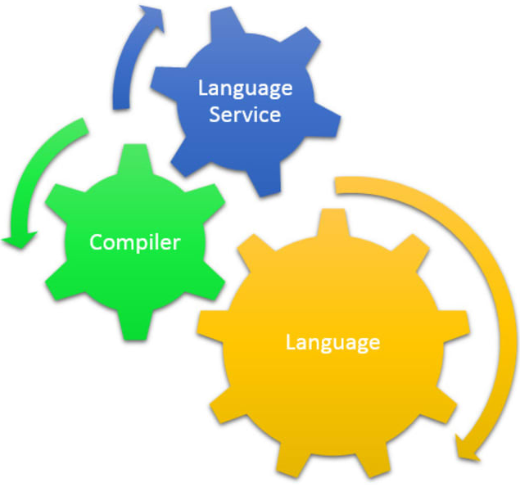
TypeScript comprises of …
Language
Compiler – open source, written in Typescript
Tooling - Visual Studio language service, browser hosted playgroundLibraries
Libraries - Static typing of DOM, jQuery, node.js

Slide 13
Features
Type Annotations

Slide 14
Types
Primitive Types
Number Boolean String
Object Types
Classes, Modules, Interfaces

Slide 15
Type Annotation
Any
Any Type is a super set of all types
var x : any;
var y;
Primitive
Number
Does not have separate integer and float/double type.
var num : number = 20;
var num = 20;
String
Both single quote or double quotes can be used.
var name : string = “hello”;
var name =’hello’;
Bool
var isOpen =true;
Notes:
All numbers in Typescript are floating point values.
These floating point numbers get the type 'number'.

Slide 16
Type Annotation
Void
Used as the return type of functions that don’t return any value
Object Types
class, interface, module.
Array
Array types can be written in:
var list: number[] = [1, 2, 3];
var list: Array<number> = [1, 2, 3];
var list:any[] = [1, true, "free"]
Enum
enum Color { Red, Green, Blue };
var color = Color.Blue;

Slide 17
Type Annotation
Tuple
Tuple types allow you to express an array where the type of a fixed number of elements is known.
var x: [string, number];
x = ['hello', 10];
Notes:
automatic semicolon insertion

Slide 18
Classes and modules
Scalable application structuring Classes, Modules, and Interfaces enable clear contracts between components
Aligned with emerging standards
Class, Module, and Arrow Function syntax aligns with ECMAScript 6 proposals
Supports popular module systems
CommonJS and AMD modules in any ECMAScript 3 compatible environment

Slide 19
TypeScript Lab

Slide 20
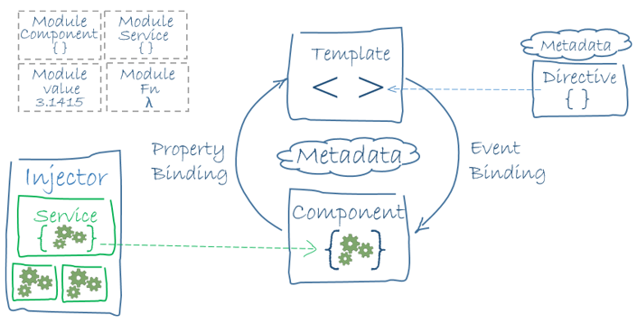
ARchitecture
Architecure

Slide 21
Features & Benefits
CROSS PLATFORM
Progressive Web Apps
Native
Desktop
SPEED AND PERFORMANCE
Code Generation
Universal
Code Splitting
PRODUCTIVITY
Templates
Angular CLI
IDEs
FULL DEVELOPMENT STORY
Testing
Animation
Accessibility

Slide 22
Angular CLI

Slide 23
Templates, Interpolation, and Directives
Interpolation
One way binding
From component class property to an element property.
Defined with double curly braces
- Contains a template expression
- No quote needed
Directive (
Structural Directives
*ngIf: If logic
*ngFor: For loops

Slide 24
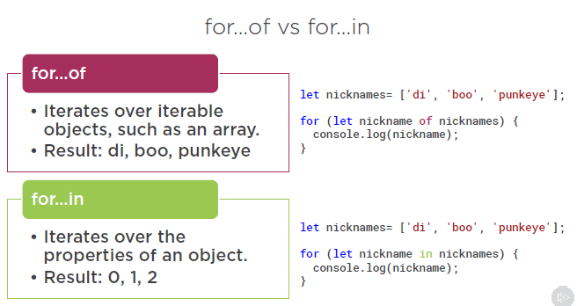
Templates, Interpolation, and Directives
NgFor
- Show template variable
*ngFor='let product of products'>

Slide 25
Data Binding & Pipes

Slide 26
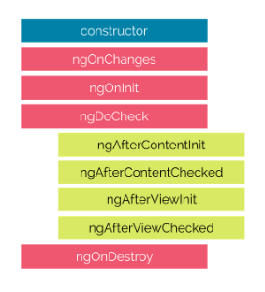
Life Cycle Hooks

Slide 27
Forms

Slide 28
Template Driven Forms

Slide 29
Reactive Forms

Slide 30
Angular Lab

Slide 31
Services and Dependency Injection

Slide 32
Retrieving Data Using Http

Slide 33
Navigation and Routing

Slide 34
Build

Slide 35
Unit Testing

